Slide 1


Dual Integral Quadratic Constraints for Robust Control of Partial Integral Equations
An engineering overview
T.M. Lenssen – supervisor: Amritam Das
CS – System & Control / 30-09-2026

Slide 2





Rigid body representation
Ordinary Differential Equation (ODE)
Flexible body representation
Partial Differential Equation (PDE)
Notes:
This slide serves as an intuitive yet insightful slide to explain PDEs, it shows the limitations of a rigid body representation as we push for performance where partial differential equations could better capture the flexmodes of the system such that we can account for them in analysis, observation or controlling the system.
That additional detail comes with greater complexity: PDE models involve infinitely many modes, spatial distributed dynamics, and boundary conditions, making analysis and design more challenging.

Slide 3





ASML wafer stage
Canon Production Printing
Parkinsons Disease
Wave/beam equations (PDE)
Diffusion-Reaction Equations (PDE)
Differential Delay Equations
(DDE -> PDE)
Notes:
This is especially relevant at ASML, where we want to achieve as much throughput as possible. The wafer stage carries the chips and needs to move as fast as possible, while still reaching nanometer-level precision.
This creates a trade-off between weight and stiffness. A lighter stage can move faster under the same forces, but it also becomes more flexible, which makes it harder to position accurately. As we saw on the previous slide, this flexibility can be described using partial differential equations instead of ordinary, or lumped, differential equations. Typical examples are wave and beam equations.
Another example is large-scale production printing at Canon in Venlo. If a wet piece of paper dries in an uncontrolled way, it can wrinkle or deform. The same problem appears in printing, because the paper becomes slightly wet during the printing process and then needs to be dried in a controlled way.
Again, there is a trade-off between throughput and quality. Drying faster increases production speed, but if the temperature or moisture is not distributed evenly across the paper, the paper can deform. Since heat and moisture vary across both space and time, this again naturally leads to partial differential equations.
The final, seemingly unrelated example is Parkinson’s disease. In a healthy person, the cortex generates possible actions and sends this information to the basal ganglia. The basal ganglia help select which actions should be carried out and which should be suppressed. This information is then passed through the thalamus back to the motor cortex, which helps execute the movement.
In patients with Parkinson’s disease, this selection mechanism is disturbed because of a loss of dopamine. As a result, the basal ganglia suppress movement too strongly, making it harder to start and control movements. This leads to symptoms such as slow movement, stiffness, and tremor.
Although this problem looks very different from a wafer stage or a drying sheet of paper, it also involves dynamics that are distributed over space. In all three examples, the main challenge is the same: we want to understand and control systems whose behavior cannot be described well by only a few lumped variables.

Slide 4

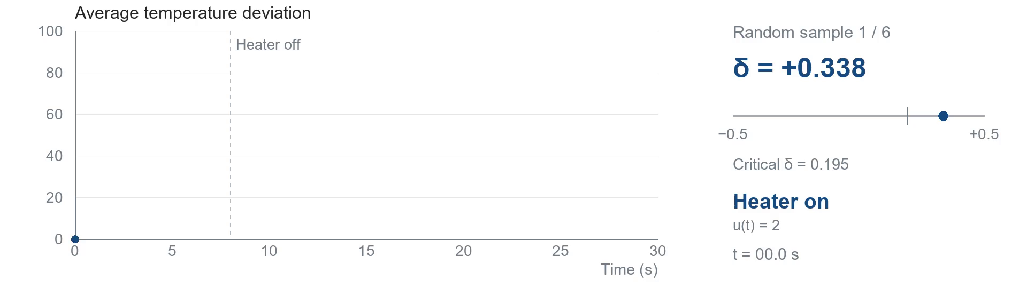
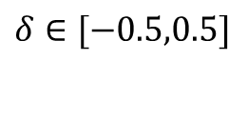
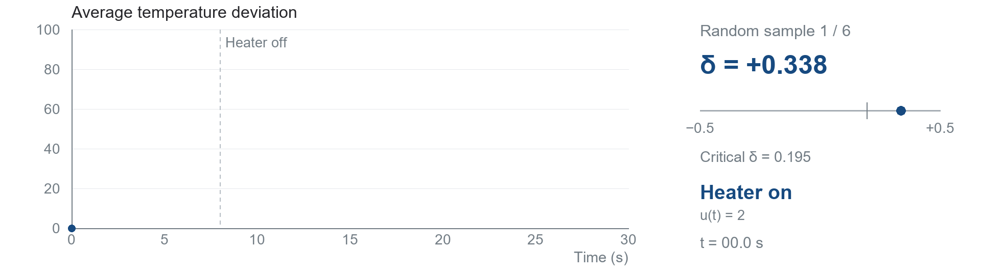
$$δ∈[−0.5,0.5]$$
$$t_{t}\left(t,s\right)=0.01 t_{ss}\left(t,s\right)+\left[\underset{\text{heat generation}}{\underbrace{0.25\left(1+δ\right)}}−\underset{\text{cooling}}{\underbrace{0.2}}\right]t\left(t,s\right)+u\left(t\right)$$
Notes:
To explain robust control, let’s take a simplified version of our printing process. See here the model of a cross-section of a piece of paper. For illustrative purposes, suppose it is heated up during the printing process, after which it needs to be cooled. Let’s also suppose our piece of paper is very poor at conducting heat.
This cooling is affected by the ambient temperature in the spot where the printer is situated, which can deviate from day to day, for example due to the weather or air-conditioning settings. This deviation is captured by the variable $δ$. As we increase $δ$, we increase the ambient temperature and thus make it more difficult for our paper to cool down.
At some point, our poorly heat-conducting paper can no longer dissipate enough heat and no longer behaves as desired and thus start to heat up. One example of robust analysis is then to determine for which values of $δ$the paper still cools down properly, without having to simulate the system for an infinite number of possible values of $δ$.
This robust analysis problem was the focus of my internship. For my graduation thesis, I then took the next step and focused on robust control: not only determining whether the system behaves correctly under uncertainty, but designing a controller that makes sure it does.

Slide 5


Slide 7


Neural Mass Model
$$\begin{aligned}z_{S}\left(t\right)&=−x_{G}\left(t−τ_{GS}\right), \\ z_{G}\left(t\right)&=x_{S}\left(t−τ_{SG}\right)−x_{G}\left(t−τ_{GG}\right), \\ \\ \end{aligned}$$
[2] Firing rate models
Notes:
In de praktijk wordt er een elektrode op de stn gezet om deep brain stimulation.
Correlatie tussen oscilatie en traagheid van bewegingen. Dus de vraag is dan kunnen we het brein zo stimuleren dat we de oscilaties verminderen
Remende effect is inhibitory
Gaspedaal is exhibitory

Slide 8


Neural Mass Model
$$\begin{aligned}z_{S}\left(t\right)&=−x_{G}\left(t−τ_{GS}\right), \\ z_{G}\left(t\right)&=x_{S}\left(t−τ_{SG}\right)−x_{G}\left(t−τ_{GG}\right), \\ \\ \end{aligned}$$
[2] Firing rate models
Notes:
In de praktijk wordt er een elektrode op de stn gezet om deep brain stimulation.
Correlatie tussen oscilatie en traagheid van bewegingen. Dus de vraag is dan kunnen we het brein zo stimuleren dat we de oscilaties verminderen
Remende effect is inhibitory
Gaspedaal is exhibitory

Slide 9


Neural Mass Model
$$\begin{aligned}z_{S}\left(t\right)&=−w_{GS}x_{G}\left(t−τ_{GS}\right), \\ z_{G}\left(t\right)&=w_{SG}x_{S}\left(t−τ_{SG}\right)−w_{GG}x_{G}\left(t−τ_{GG}\right), \\ \\ \end{aligned}$$
[2] Firing rate models
Notes:
In de praktijk wordt er een elektrode op de stn gezet om deep brain stimulation.
Correlatie tussen oscilatie en traagheid van bewegingen. Dus de vraag is dan kunnen we het brein zo stimuleren dat we de oscilaties verminderen
Remende effect is inhibitory
Gaspedaal is exhibitory

Slide 10
Neural Mass Model
$$\begin{aligned}z_{S}\left(t\right)&=−w_{GS}x_{G}\left(t−τ_{GS}\right), \\ z_{G}\left(t\right)&=w_{SG}x_{S}\left(t−τ_{SG}\right)−w_{GG}x_{G}\left(t−τ_{GG}\right), \\ \\ \end{aligned}$$
[2] Firing rate models
Notes:
In de praktijk wordt er een elektrode op de stn gezet om deep brain stimulation.
Correlatie tussen oscilatie en traagheid van bewegingen. Dus de vraag is dan kunnen we het brein zo stimuleren dat we de oscilaties verminderen
Remende effect is inhibitory
Gaspedaal is exhibitory

Slide 11


Neural Mass Model
$$\begin{aligned}z_{S}\left(t\right)&=−w_{GS}x_{G}\left(t−τ_{GS}\right), \\ z_{G}\left(t\right)&=w_{SG}x_{S}\left(t−τ_{SG}\right)−w_{GG}x_{G}\left(t−τ_{GG}\right), \\ τ_{S}{\dot{x}}_{S}\left(t\right)&=δ_{S}\left(z_{S}\left(t\right)\right)−x_{S}\left(t\right), \\ τ_{G}{\dot{x}}_{G}\left(t\right)&=δ_{G}\left(z_{G}\left(t\right)\right)−x_{G}\left(t\right).\end{aligned}$$
Model contains delays and nonlinear activation funtions!
[2] Firing rate models
Notes:
In de praktijk wordt er een elektrode op de stn gezet om deep brain stimulation.
Correlatie tussen oscilatie en traagheid van bewegingen. Dus de vraag is dan kunnen we het brein zo stimuleren dat we de oscilaties verminderen
Remende effect is inhibitory
Gaspedaal is exhibitory

Slide 12


Neural Mass Model
$$\begin{aligned}z_{S}\left(t\right)&=−w_{GS}x_{G}\left(t−τ_{GS}\right), \\ z_{G}\left(t\right)&=w_{SG}x_{S}\left(t−τ_{SG}\right)−w_{GG}x_{G}\left(t−τ_{GG}\right), \\ τ_{S}{\dot{x}}_{S}\left(t\right)&=δ_{S}\left(z_{S}\left(t\right)\right)−x_{S}\left(t\right)+u\left(t\right), \\ τ_{G}{\dot{x}}_{G}\left(t\right)&=δ_{G}\left(z_{G}\left(t\right)\right)−x_{G}\left(t\right).\end{aligned}$$
[2] Firing rate models
Notes:
In de praktijk wordt er een elektrode op de stn gezet om deep brain stimulation.
Correlatie tussen oscilatie en traagheid van bewegingen. Dus de vraag is dan kunnen we het brein zo stimuleren dat we de oscilaties verminderen
Remende effect is inhibitory
Gaspedaal is exhibitory

Slide 13
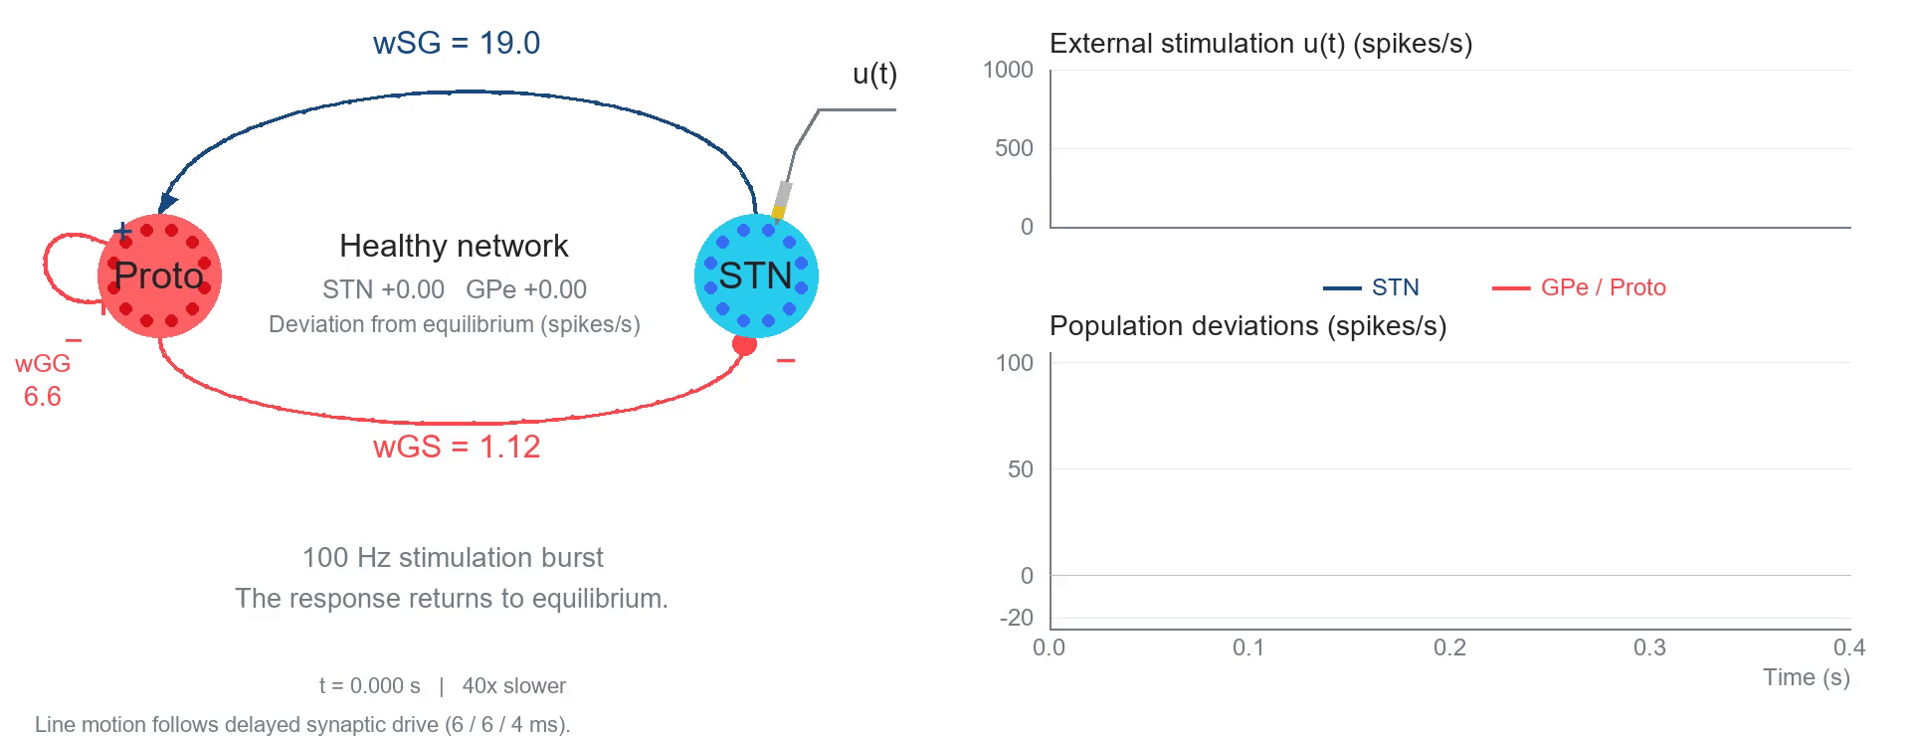
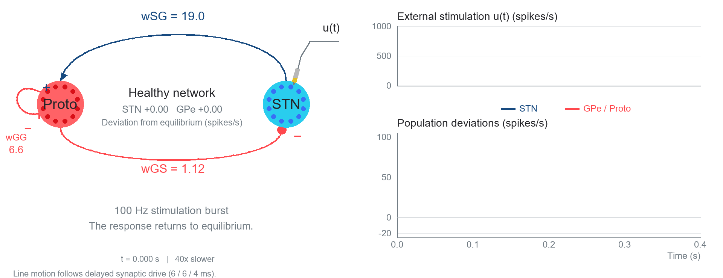
Brain Stimulation
[2] Firing rate models
Notes:
In de praktijk wordt er een elektrode op de stn gezet om deep brain stimulation.
Correlatie tussen oscilatie en traagheid van bewegingen. Dus de vraag is dan kunnen we het brein zo stimuleren dat we de oscilaties verminderen
Remende effect is inhibitory
Gaspedaal is exhibitory

Slide 14
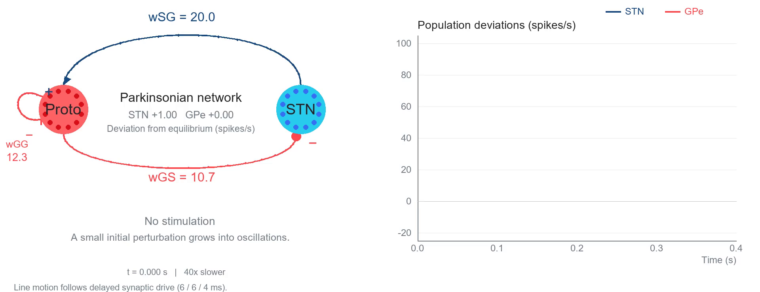

Beta-oscillations
[2] Firing rate models
Notes:
In de praktijk wordt er een elektrode op de stn gezet om deep brain stimulation.
Correlatie tussen oscilatie en traagheid van bewegingen. Dus de vraag is dan kunnen we het brein zo stimuleren dat we de oscilaties verminderen
Remende effect is inhibitory
Gaspedaal is exhibitory

Slide 15
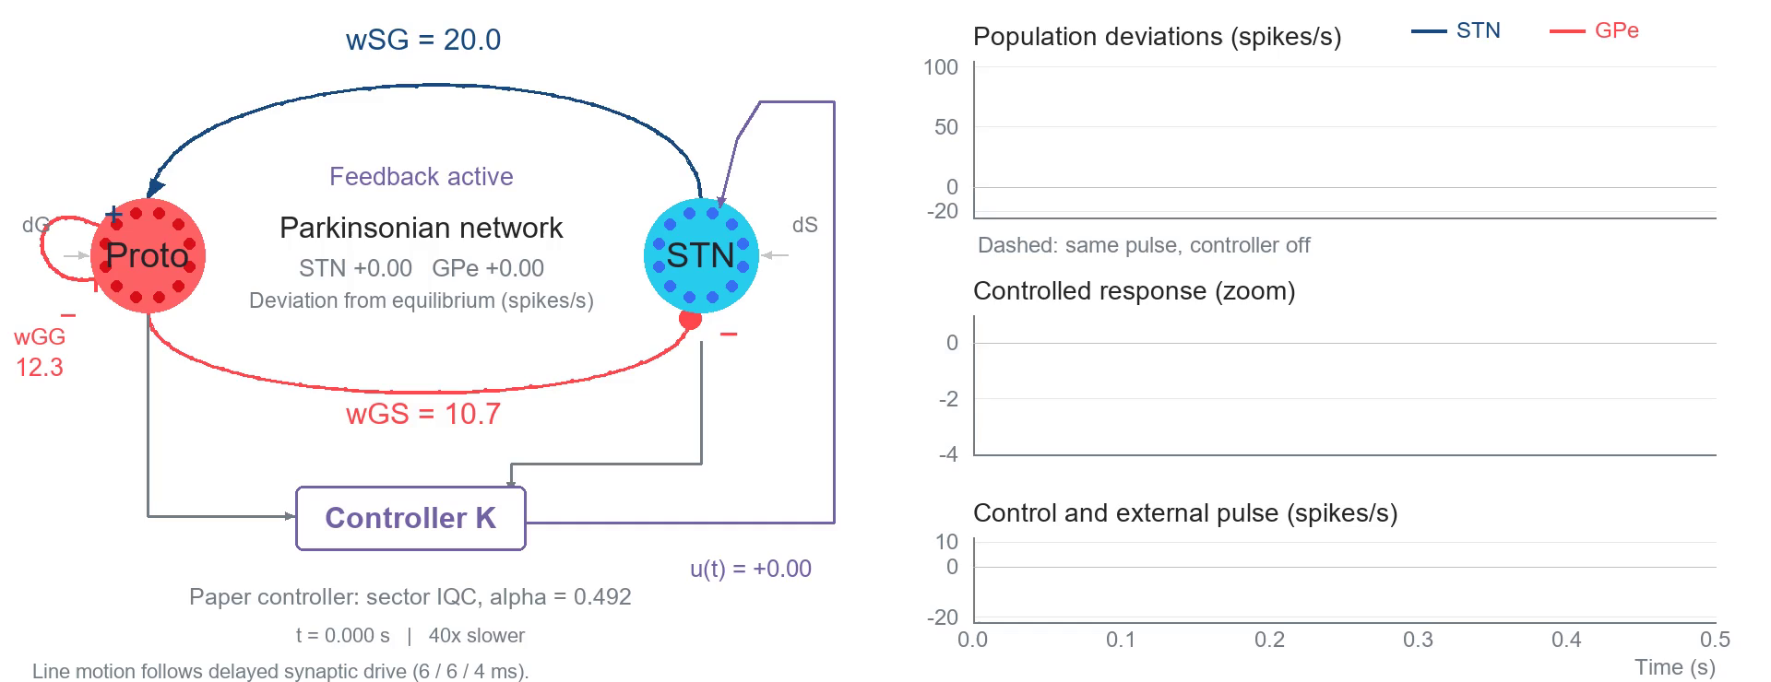

Feedback stabilization
Paper controller: external pulse at 0.10-0.14 s; dashed trajectories show controller off.

Slide 16
Goal: Develop a unified framework to analyse and control a broad class of distributed systems.
Analysis capabilities
Convex state feedback synthesis

Slide 17
Goal: Develop a unified framework to analyse and control a broad class of distributed systems.
Analysis capabilities
Convex state feedback synthesis

Slide 18
Goal: Develop a unified framework to analyse and control a broad class of distributed systems.
Analysis capabilities
Convex state feedback synthesis
Main contribution
Notes:
Assume full state information is known
Needs to be satisfied for all uncertainty, infinite dimensional system, uncertainty
Thinking of discretization have already lost the battle, the physics of the system determines that PDE is the representation of the system. First thing AI tries to do is discretize the model

Slide 19

$$\begin{aligned}z_{S}\left(t\right)&=−w_{GS}x_{G}\left(t−τ_{GS}\right), \\ z_{G}\left(t\right)&=w_{SG}x_{S}\left(t−τ_{SG}\right)−w_{GG}x_{G}\left(t−τ_{GG}\right), \\ τ_{S}{\dot{x}}_{S}\left(t\right)&=δ_{S}\left(z_{S}\left(t\right)\right)−x_{S}\left(t\right)+u\left(t\right), \\ τ_{G}{\dot{x}}_{G}\left(t\right)&=δ_{G}\left(z_{G}\left(t\right)\right)−x_{G}\left(t\right).\end{aligned}$$
[2] Firing rate models
Notes:
In de praktijk wordt er een elektrode op de stn gezet om deep brain stimulation.
Correlatie tussen oscilatie en traagheid van bewegingen. Dus de vraag is dan kunnen we het brein zo stimuleren dat we de oscilaties verminderen
Remende effect is inhibitory
Gaspedaal is exhibitory

Slide 20
Partial Integral Equations
Equivalent dynamics
Built in boundary conditions
Bounded operators
Matrix-like algebra
LMI-like computations
Controller synthesis for linear systems…..
ODE-PDE
PIE
Exact!
Notes:
Partial Differential Equations give a natural way to describe distributed systems, but stability analysis, observer design, and controller synthesis are challenging. Spatially distributed dynamics and boundary conditions complicate the application of large amount of theory that has been developed for ordinary differential equations.
More recently, partial differential equations have been introduced as an alternative representation that brings much of the properties of ODEs to partial differential equations.

Slide 21


Partial Integral Equations
Equivalent dynamics
Built in boundary conditions
Bounded operators
Matrix-like algebra
LMI-like computations
Controller synthesis for linear systems…..
ODE-PDE
PIE
Exact!
$$\dot{T}\left(t,s\right)=T\left(t,s\right)$$
$$T\left(t,0\right)=w_{1}\left(t\right)$$
$$T_{s}\left(t,0\right)=w_{2}(t)$$
$$\begin{aligned}\dot{u}\left(t,s\right)=w_{1}\left(t\right) \\ +sw_{2}\left(t\right) \\ +\int_{0}^{s}{\left(s−ξ\right)}u_{ξξ}\left(t,ξ\right)dξ\end{aligned}$$
Notes:
Partial Differential Equations give a natural way to describe distributed systems, but stability analysis, observer design, and controller synthesis are challenging. Spatially distributed dynamics and boundary conditions complicate the application of large amount of theory that has been developed for ordinary differential equations.
More recently, partial differential equations have been introduced as an alternative representation that brings much of the properties of ODEs to partial differential equations.
Manner prose

Slide 22
Partial Integral Equations
Equivalent dynamics
Built in boundary conditions
Bounded operators
Matrix-like algebra
LMI-like computations
Controller synthesis for linear systems…..
ODE-PDE
PIE
Exact!
$$𝒯{\dot{x}}_{f}\left(t\right)=𝒜x_{f}\left(t\right)+ℬw\left(t\right)$$
$$z\left(t\right)=𝒞x_{f}\left(t\right)+𝒟w\left(t\right)$$
$$𝒯,𝒜,....∈Π_{4}$$
Notes:
Partial Differential Equations give a natural way to describe distributed systems, but stability analysis, observer design, and controller synthesis are challenging. Spatially distributed dynamics and boundary conditions complicate the application of large amount of theory that has been developed for ordinary differential equations.
More recently, partial differential equations have been introduced as an alternative representation that brings much of the properties of ODEs to partial differential equations.

Slide 23
Partial Integral Equations
Equivalent dynamics
Built in boundary conditions
Bounded operators
Matrix-like algebra
LMI-like computations
Controller synthesis for linear systems…..
ODE-PDE
PIE
Exact!
$$𝒜+ℬ∈Π_{4}, 𝒜ℬ∈Π_{4}, 𝒜^{∗}∈Π_{4}, \left[\begin{matrix}𝒜 & ℬ\end{matrix}\right]∈Π_{4}$$
Notes:
Partial Differential Equations give a natural way to describe distributed systems, but stability analysis, observer design, and controller synthesis are challenging. Spatially distributed dynamics and boundary conditions complicate the application of large amount of theory that has been developed for ordinary differential equations.
More recently, partial differential equations have been introduced as an alternative representation that brings much of the properties of ODEs to partial differential equations.

Slide 24
Partial Integral Equations
Equivalent dynamics
Built in boundary conditions
Bounded operators
Matrix-like algebra
LMI-like computations
Controller synthesis for linear systems…..
ODE-PDE
PIE
Exact!
Exponential stability of PDE
$$∃𝒫≻0, 𝒯^{∗}𝒫𝒜+𝒜^{∗}𝒫𝒯⪯−α𝒯^{∗}𝒫𝒯$$
Notes:
Partial Differential Equations give a natural way to describe distributed systems, but stability analysis, observer design, and controller synthesis are challenging. Spatially distributed dynamics and boundary conditions complicate the application of large amount of theory that has been developed for ordinary differential equations.
More recently, partial differential equations have been introduced as an alternative representation that brings much of the properties of ODEs to partial differential equations.

Slide 25
Partial Integral Equations
Equivalent dynamics
Built in boundary conditions
Bounded operators
Matrix-like algebra
LMI-like computations
Controller synthesis for linear systems…..
ODE-PDE
PIE
Exact!
Cite gpde application
Notes:
Partial Differential Equations give a natural way to describe distributed systems, but stability analysis, observer design, and controller synthesis are challenging. Spatially distributed dynamics and boundary conditions complicate the application of large amount of theory that has been developed for ordinary differential equations.
More recently, partial differential equations have been introduced as an alternative representation that brings much of the properties of ODEs to partial differential equations.
Five steps PDE to PIE,

Slide 26
Robust Stability and Performance
Notes:
For illustrative purposes, suppose this model the moisture and heat content of a piece of paper as it exits

Slide 27
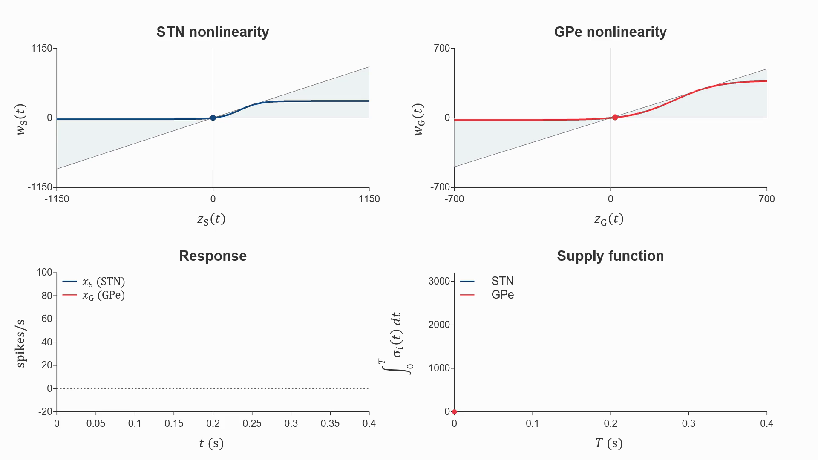

Notes:
Parkinsonian GPe-STN sector simulation. Each channel satisfies q_i=w_i(beta_i*z_i-w_i)>=0. The supply function panel plots the accumulated supply integral, giving the hard IQC and dissipativity with zero storage. beta_S=0.7344121335837432, beta_G=0.7048314668921489. Click to play the embedded clean 4K video; all text and math labels are editable PowerPoint overlays.
This says that the increase in stored energy cannot exceed the supplied energy. It is a supply–storage balance, so you can explain it without introducing a Lyapunov stability argument.

Slide 28
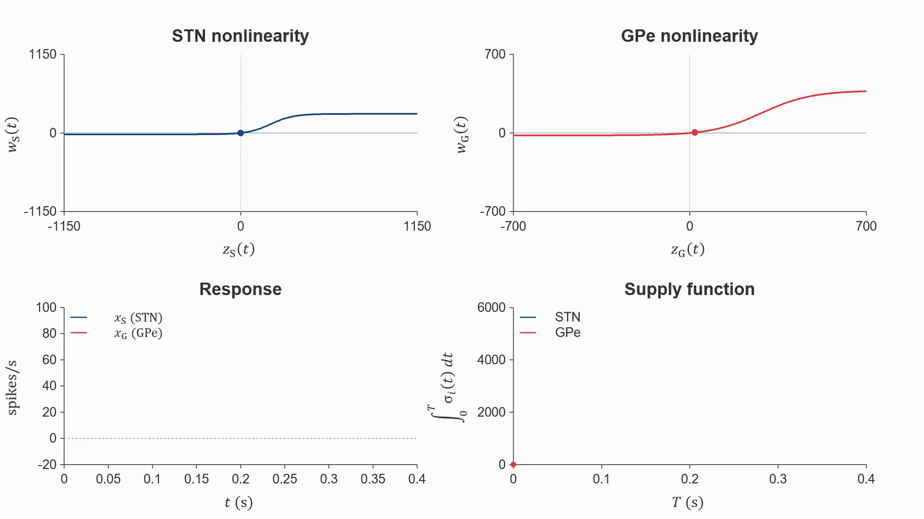

Notes:
# STN–GPe Zames–Falb simulation
Uses the three-pole multiplier in Section 9 of the manuscript:
M(s)=1-H(s), H(s)=sum_k kappa_k/(s+a_k),
a=(1/.014,1/.006,1/.004), kappa_k=(2/3)*(10.7,20,12.3)_k/43*a_k.
The filter starts at zero. Its impulse response is nonnegative and has L1 norm 2/3.
The nonlinearities, delays, initial history, and response are exactly those of the sector demonstration.
Global slope alpha=1 is used. The synthesis value .562 is local and does not cover this trajectory.
The supply q_i=2*w_i*(alpha*z_i-w_i-H(alpha*z_i-w_i)) matches the paper's unregularized matrix normalization.
The integral can decrease while remaining nonnegative. This is a hard IQC for this causal realization.
It does not assert stability of the feedback interconnection, or identify the IQC integral with physical energy.
The HTML has editable DOM labels and switches between accumulated supply and instantaneous supply.
The 4K video and poster contain no baked labels; the accompanying PowerPoint has editable text/math overlays.
Regenerate: python Presentation/SectorIQC/simulate_zames_falb.py
Render: python Presentation/SectorIQC/render_zames_falb.py
The plotted integrals are accumulated supplies, not storage functions. Nonnegativity of a storage function alone does not prove dissipativity; the supply inequality is essential. Sector IQCs permit zero storage directly. Dynamic IQCs describe the filtered signals and can require filter storage in a state-space interpretation.

Slide 29
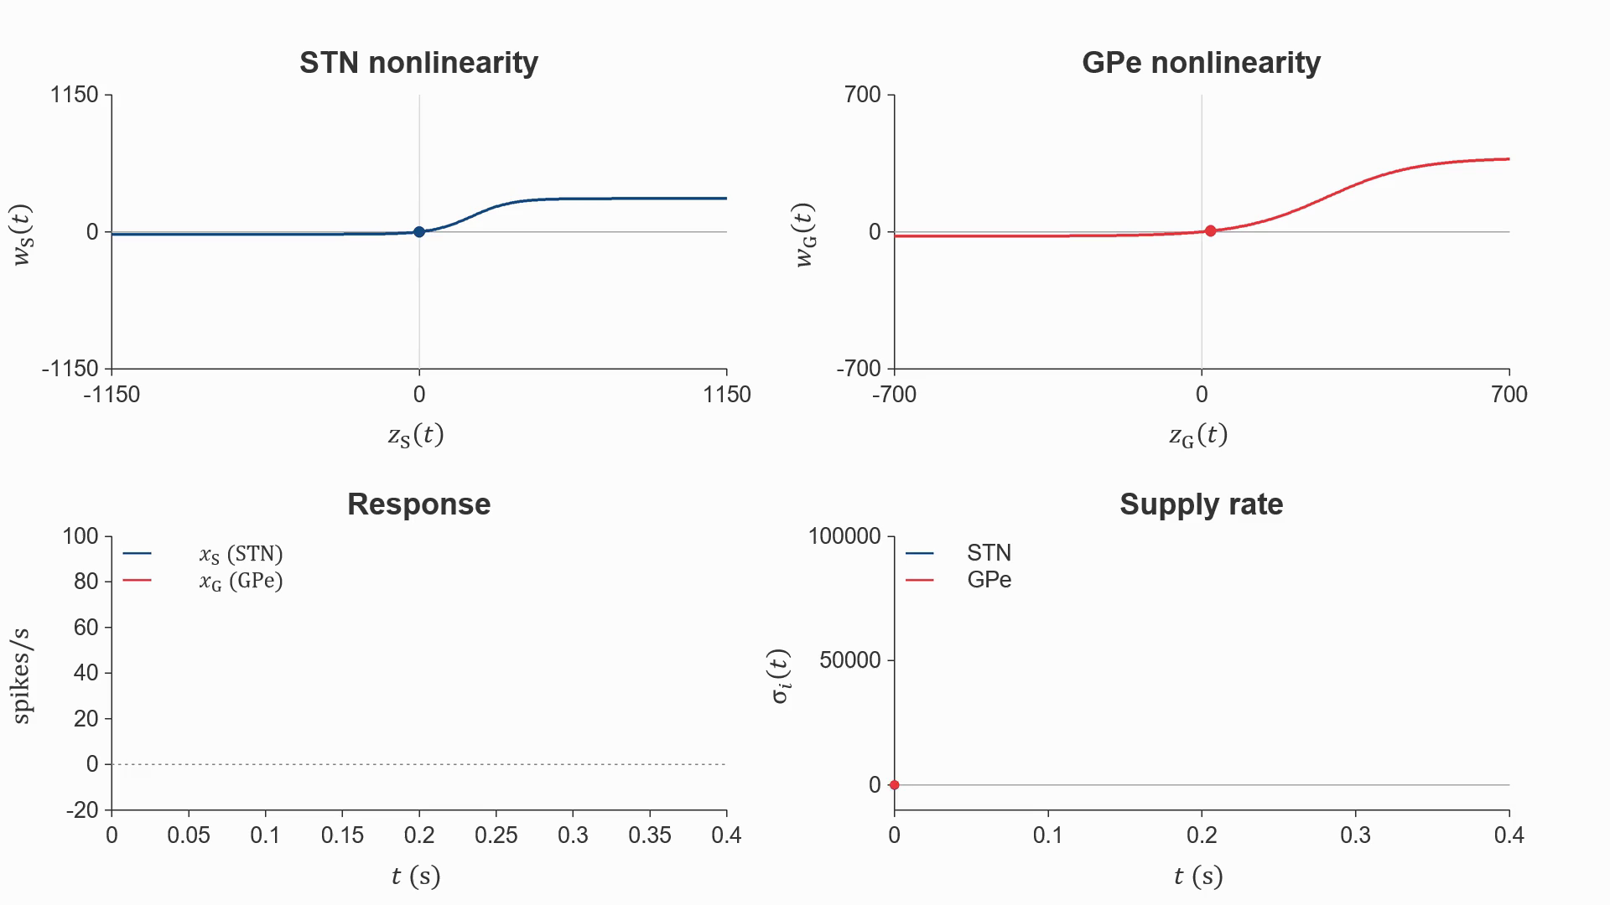

Notes:
# STN–GPe Zames–Falb simulation
Uses the three-pole multiplier in Section 9 of the manuscript:
M(s)=1-H(s), H(s)=sum_k kappa_k/(s+a_k),
a=(1/.014,1/.006,1/.004), kappa_k=(2/3)*(10.7,20,12.3)_k/43*a_k.
The filter starts at zero. Its impulse response is nonnegative and has L1 norm 2/3.
The nonlinearities, delays, initial history, and response are exactly those of the sector demonstration.
Global slope alpha=1 is used. The synthesis value .562 is local and does not cover this trajectory.
The supply q_i=2*w_i*(alpha*z_i-w_i-H(alpha*z_i-w_i)) matches the paper's unregularized matrix normalization.
The integral can decrease while remaining nonnegative. This is a hard IQC for this causal realization.
It does not assert stability of the feedback interconnection, or identify the IQC integral with physical energy.
The HTML has editable DOM labels and switches between accumulated supply and instantaneous supply.
The 4K video and poster contain no baked labels; the accompanying PowerPoint has editable text/math overlays.
Regenerate: python Presentation/SectorIQC/simulate_zames_falb.py
Render: python Presentation/SectorIQC/render_zames_falb.py
The plotted integrals are accumulated supplies, not storage functions. Nonnegativity of a storage function alone does not prove dissipativity; the supply inequality is essential. Sector IQCs permit zero storage directly. Dynamic IQCs describe the filtered signals and can require filter storage in a state-space interpretation.

Slide 30



Analysis
Replace $∆$ with some scaling
Cost function
Msc Defence T.M. Lenssen
29
Notes:
We use \gamma as a performance metric, where a lower gamma implies we can push for more performance. Before analyzing robust stability and performance we need to do something about this Delta as it makes analysis harder.
Introduce IQC for parametric uncertainty things we can do, keep the promise to show another example
Introduce duality argument for sector bounded uncertainty

Slide 31


Analysis
Replace $∆$ with some scaling
Cost function
Convex for analysis!
Msc Defence T.M. Lenssen
29
Notes:
We use \gamma as a performance metric, where a lower gamma implies we can push for more performance. Before analyzing robust stability and performance we need to do something about this Delta as it makes analysis harder.

Slide 32


Analysis
Final representation the system
Replace $∆$ with some scaling
Cost function
Msc Defence T.M. Lenssen
29
Notes:
We use \gamma as a performance metric, where a lower gamma implies we can push for more performance. Before analyzing robust stability and performance we need to do something about this Delta as it makes analysis harder.

Slide 33

Let’s analyse!
Msc Defence T.M. Lenssen
29
Notes:
We use \gamma as a performance metric, where a lower gamma implies we can push for more performance. Before analyzing robust stability and performance we need to do something about this Delta as it makes analysis harder.

Slide 34







Absorbing the controller into the filter
$$G: T\dot{x}=Ax+B_{u}u, y=x$$
What do we expect?
$$u=Ky ⇒ T\dot{x}=\left(A+B_{u}K\right)x$$
$$G$$
What do we get?
$$u$$
$$y$$
$$Θ := \left\{\begin{aligned}\left[\begin{matrix}\tilde{y} \\ \tilde{u}\end{matrix}\right]=\left[\begin{matrix}I & 0 \\ −K & I\end{matrix}\right]\left[\begin{matrix}y \\ u\end{matrix}\right]\end{aligned}\right.$$
$$K$$
$$\tilde{u}=u−Ky ⇔ u=Ky+\tilde{u}$$
$$\left\{\begin{aligned}T\dot{x}=\left(A+B_{u}K\right)x+B_{u}\tilde{u} \\ \tilde{y}=y=x\end{aligned}\right.$$
$$\tilde{y}$$
$$Θ$$
$$\tilde{u}$$
Is this correct?
$$\tilde{u}=0 ⇔ u=Ky$$
Yes: filtered input recovers the original closed loop.

Slide 35







Transposing the systems
For this illustration, state and input have equal dimension.
What do we expect?
$$\tilde{\underline{u}}=0 ⇔ \underline{u}=K^{∗}\underline{y}$$
$$G^{⊤}$$
What do we get?
$$\underline{u}$$
$$\underline{y}$$
$$G^{⊤}: \left\{\begin{aligned}T^{∗}\dot{\underline{x}}=A^{∗}\underline{x}+\underline{u} \\ \underline{y}={B_{u}}^{∗}\underline{x}\end{aligned}\right.$$
$$K^{⊤}$$
$$Θ^{⊤} := \left\{\begin{aligned}\left[\begin{matrix}\tilde{\underline{y}} \\ \tilde{\underline{u}}\end{matrix}\right]=\left[\begin{matrix}I & −K^{∗} \\ 0 & I\end{matrix}\right]\left[\begin{matrix}\underline{y} \\ \underline{u}\end{matrix}\right]\end{aligned}\right.$$
$$\underline{\overset{˜}{y}}$$
$$Θ^{⊤}$$
$$\underline{\overset{˜}{u}}$$
Is this correct?
$$\tilde{\underline{u}}=\underline{u}=K^{∗}\underline{y}≠0$$
Generally nonzero under dual feedback.
No: zero filtered input imposes the wrong constraint.

Slide 36


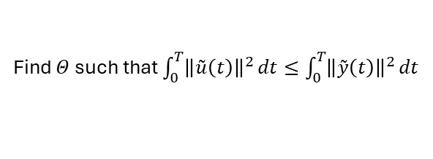





Thought experiment replace $K$ by $Θ$
Find $Θ$ such that $\int_{0}^{T}{{\left\|\overset{˜}{u}\left(t\right)\right\|}^{2}}dt≤\int_{0}^{T}{{\left\|\overset{˜}{y}\left(t\right)\right\|}^{2}}dt$
$$G$$
$$u$$
$$y$$
Set $\overset{˜}{u}\left(t\right)=0$ then this holds for any $\overset{˜}{y}\left(t\right)$
$$K$$
$$\left[\begin{matrix}\overset{˜}{y}\left(t\right) \\ 0\end{matrix}\right]=\left[\begin{matrix}Θ_{11} & Θ_{12} \\ Θ_{21} & Θ_{22}\end{matrix}\right]\left[\begin{matrix}y\left(t\right) \\ u\left(t\right)\end{matrix}\right]$$
Pick $Θ_{11}=I,Θ_{12}=0$
$$u\left(t\right)=Ky\left(t\right)$$
$$Θ$$
Thus $Θ_{21}=−K,Θ_{22}=I$
$$Θ=\left[\begin{matrix}I & 0 \\ −K & I\end{matrix}\right]$$

Slide 37


Thought experiment replace $K^{⊤}$ by $\underline{Θ}$
We can follow the same steps on the dual side and find
$$G^{⊤}$$
$$\underline{Θ}=\left[\begin{matrix}I & 0 \\ −K^{⊤} & I\end{matrix}\right]$$
$$\underline{u}$$
$$\underline{y}$$
$$K^{⊤}$$
$$\underline{\overset{˜}{y}}$$
$$\underline{Θ}$$
$$\underline{\overset{˜}{u}}$$

Slide 38














Comparing our results
$$G^{⊤}$$
$$G$$
$$\underline{u}$$
$$\underline{y}$$
$$u$$
$$y$$
$$K^{⊤}$$
$$K$$
$$\underline{\overset{˜}{y}}$$
$$Θ$$
$$\underline{Θ}$$
$$\underline{\overset{˜}{u}}$$
$$Θ=\left[\begin{matrix}I & 0 \\ −K & I\end{matrix}\right]$$
$$\underline{Θ}=\left[\begin{matrix}I & 0 \\ −K^{⊤} & I\end{matrix}\right]$$
We see that $Θ≠{\underline{Θ}}^{⊤}$ so what operation could possibly describe this relation?

Slide 39
The dual operation
What do we expect?
Filtering the dual system must give
the dual of the transformed system.
$$G^{⊤}$$
$$\underline{u}$$
$$\underline{y}$$
What do we get?
$$K^{⊤}$$
$$D\left(Θ\right):={\left({\hat{J}}^{∗}Θ^{⊤}\hat{J}\right)}^{−1}$$
$$\hat{J}=\left[\begin{matrix}0 & I \\ −I & 0\end{matrix}\right]$$
$$\underline{\overset{˜}{y}}$$
$$D\left(Θ\right)$$
$$\underline{\overset{˜}{u}}$$
Is this correct?
Recover the expected dual closed loop.
Next: apply this operation and verify the resulting system.

Slide 40
Applying the dual filter
What do we expect?
$$T^{∗}\dot{\underline{x}}=\left(A^{∗}+K^{∗}{B_{u}}^{∗}\right)\underline{x}$$
$$G^{⊤}$$
What do we get?
$$\underline{u}$$
$$\underline{y}$$
$$D\left(Θ\right) := \left\{\begin{aligned}\left[\begin{matrix}\tilde{\underline{y}} \\ \tilde{\underline{u}}\end{matrix}\right]=\left[\begin{matrix}I & 0 \\ −K^{∗} & I\end{matrix}\right]\left[\begin{matrix}\underline{y} \\ \underline{u}\end{matrix}\right]\end{aligned}\right.$$
$$K^{⊤}$$
$$\underline{u}=K^{∗}\underline{y}+\tilde{\underline{u}}$$
$$\underline{\overset{˜}{y}}$$
$$\left\{\begin{aligned}T^{∗}\dot{\underline{x}}=\left(A^{∗}+K^{∗}{B_{u}}^{∗}\right)\underline{x}+\tilde{\underline{u}} \\ \tilde{\underline{y}}={B_{u}}^{∗}\underline{x}\end{aligned}\right.$$
$$D\left(Θ\right)$$
$$\underline{\overset{˜}{u}}$$
Is this correct?
$$\tilde{\underline{u}}=0 ⇔ \underline{u}=K^{∗}\underline{y}$$
Yes: zero filtered input recovers the dual closed loop.

Slide 41
Future work
Extending the multiplier and uncertainty class
  Infinite dimensional multipliers: real parametric, and sector bounded uncertainty
  Finite dimensional mutlipliers: Strict Positive negative multipliers

Slide 42
References
[1] B.De la Crompe, M.Deffains, A.Leblois, N.Mallet, “Reevaluating the role of the STN-Gpe network in generating beta synchronized oscillatory activity in parkinsonism.”
[2]A.J. Nevado Holgade, J.R.Terry,R.Bogacz, “Conditions for the Generation of Beta Oscillations in the Subthalamic Nucleus-Globus Pallidus Network”

Slide 43







Robust Stability and Performance
$$v_{i}\left(t,0\right)=0$$
$$∂_{s}v_{i}\left(t,1\right)=0$$
$$v_{1}$$
Heat in paper
$$v_{2}$$
Moisture in paper
$$s=0$$
$$s$$
$$s=1$$
Msc Defence T.M. Lenssen
26
Notes:
Two fields on the same spatial domain: v1 is heat deviation and v2 is moisture deviation. Full model is unchanged; introduce the states first. Both schematic profiles start at zero on the left and flatten at the no-flux right boundary, using a sin(pi*s/2)-shaped colour progression. The two simple arrows show the +v1 coupling from heat to moisture and the -3v2 coupling from moisture to heat. They indicate reaction coupling, not spatial transport. Gradients illustrate a boundary-compatible profile, not a simulation result.

Slide 44
Robust Stability and Performance
$$v_{i}\left(t,0\right)=0$$
$$∂_{s}v_{i}\left(t,1\right)=0$$
$$v_{1}$$
Heat in paper
$$v_{2}$$
Moisture in paper
$$s=0$$
$$s$$
$$s=1$$
$$∂_{t}v_{1}\left(t,s\right)=∂_{ss}v_{1}\left(t,s\right)+a\left(δ\right)v_{1}\left(t,s\right)−3v_{2}\left(t,s\right)+b\left(δ\right)sw_{p}\left(t\right)$$
$$∂_{t}v_{2}\left(t,s\right)=∂_{ss}v_{2}\left(t,s\right)+v_{1}\left(t,s\right)+\left(1+\frac{π^{2}}{2}\right)v_{2}\left(t,s\right)$$
$$z_{p}\left(t\right)=c\left(δ\right)\int_{0}^{1}{v_{1}\left(t,s\right) ds}+d\left(δ\right)w_{p}\left(t\right)$$
Msc Defence T.M. Lenssen
26
Notes:
Two fields on the same spatial domain: v1 is heat deviation and v2 is moisture deviation. Full model is unchanged; introduce the states first. Both schematic profiles start at zero on the left and flatten at the no-flux right boundary, using a sin(pi*s/2)-shaped colour progression. The two simple arrows show the +v1 coupling from heat to moisture and the -3v2 coupling from moisture to heat. They indicate reaction coupling, not spatial transport. Gradients illustrate a boundary-compatible profile, not a simulation result.

Slide 45

Robust Stability and Performance
$$v_{i}\left(t,0\right)=0$$
$$∂_{s}v_{i}\left(t,1\right)=0$$
$$v_{1}$$
Heat in paper
$$\left|δ\right|≤α$$
$$v_{2}$$
Moisture in paper
$$s=0$$
$$s$$
$$s=1$$
$$∂_{t}v_{1}\left(t,s\right)=∂_{ss}v_{1}\left(t,s\right)+a\left(δ\right)v_{1}\left(t,s\right)−3v_{2}\left(t,s\right)+b\left(δ\right)sw_{p}\left(t\right)$$
$$∂_{t}v_{2}\left(t,s\right)=∂_{ss}v_{2}\left(t,s\right)+v_{1}\left(t,s\right)+\left(1+\frac{π^{2}}{2}\right)v_{2}\left(t,s\right)$$
$$z_{p}\left(t\right)=c\left(δ\right)\int_{0}^{1}{v_{1}\left(t,s\right) ds}+d\left(δ\right)w_{p}\left(t\right)$$
Msc Defence T.M. Lenssen
27
Notes:
For illustrative purposes, suppose this model the moisture and heat content of a piece of paper as it exits

Slide 46

Robust Stability and Performance
$$v_{i}\left(t,0\right)=0$$
$$∂_{s}v_{i}\left(t,1\right)=0$$
$$v_{1}$$
Heat in paper
$$\left|δ\right|≤α$$
$$v_{2}$$
Moisture in paper
$$s=0$$
$$s$$
$$s=1$$
$$∂_{t}v_{1}\left(t,s\right)=∂_{ss}v_{1}\left(t,s\right)+a\left(δ\right)v_{1}\left(t,s\right)−3v_{2}\left(t,s\right)+b\left(δ\right)sw_{p}\left(t\right)$$
$$∂_{t}v_{2}\left(t,s\right)=∂_{ss}v_{2}\left(t,s\right)+v_{1}\left(t,s\right)+\left(1+\frac{π^{2}}{2}\right)v_{2}\left(t,s\right)$$
$$z_{p}\left(t\right)=c\left(δ\right)\int_{0}^{1}{v_{1}\left(t,s\right) ds}+d\left(δ\right)w_{p}\left(t\right)$$
Msc Defence T.M. Lenssen
28
Notes:
w_p models some heat disturbance acting on the piece of paper as it is leaving the printer, such as drying heat, warm airflow, or ambient temperature. Our performance channel z_p wants to know what effect this disturbance has on the average temperature of our sheet of paper. Lets put this equation in to a more generic form that is easier to interpret the LFR structure

Slide 47



Robust Stability and Performance
$$\left|δ\right|≤α$$
Delta: captures uncertainty
P: captures nominal/linear dynamics
Msc Defence T.M. Lenssen
29
Notes:
For illustrative purposes, suppose this model the moisture and heat content of a piece of paper as it exits

Slide 48


Robust Stability and Performance
Robust Stability: $[P,Δ]$ stable for all $\left|δ\right|≤α$
Msc Defence T.M. Lenssen
29
Notes:
For illustrative purposes, suppose this model the moisture and heat content of a piece of paper as it exits

Slide 49


Robust Stability and Performance
Robust Performance: $[P,Δ]$ stable and performance
requirements are met for all $\left|δ\right|≤α$
Msc Defence T.M. Lenssen
29
Notes:
For illustrative purposes, suppose this model the moisture and heat content of a piece of paper as it exits

Slide 50


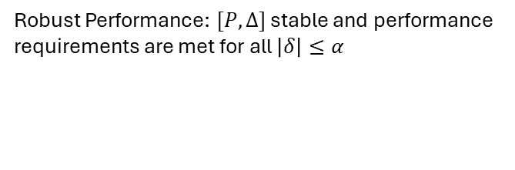
Robust Stability and Performance
Robust Performance: $[P,Δ]$ stable and performance
requirements are met for all $\left|δ\right|≤α$
Performance metric: ${\left\|z_{p}(t)\right\|}_{L_{2}}≤γ{\left\|w_{p}(t)\right\|}_{L_{2}}$
Worst case gain!
Msc Defence T.M. Lenssen
29
Notes:
We use \gamma as a performance metric, where a lower gamma implies we can push for more performance. Before analyzing robust stability and performance we need to do something about this Delta as it makes analysis harder.

